Slide 1
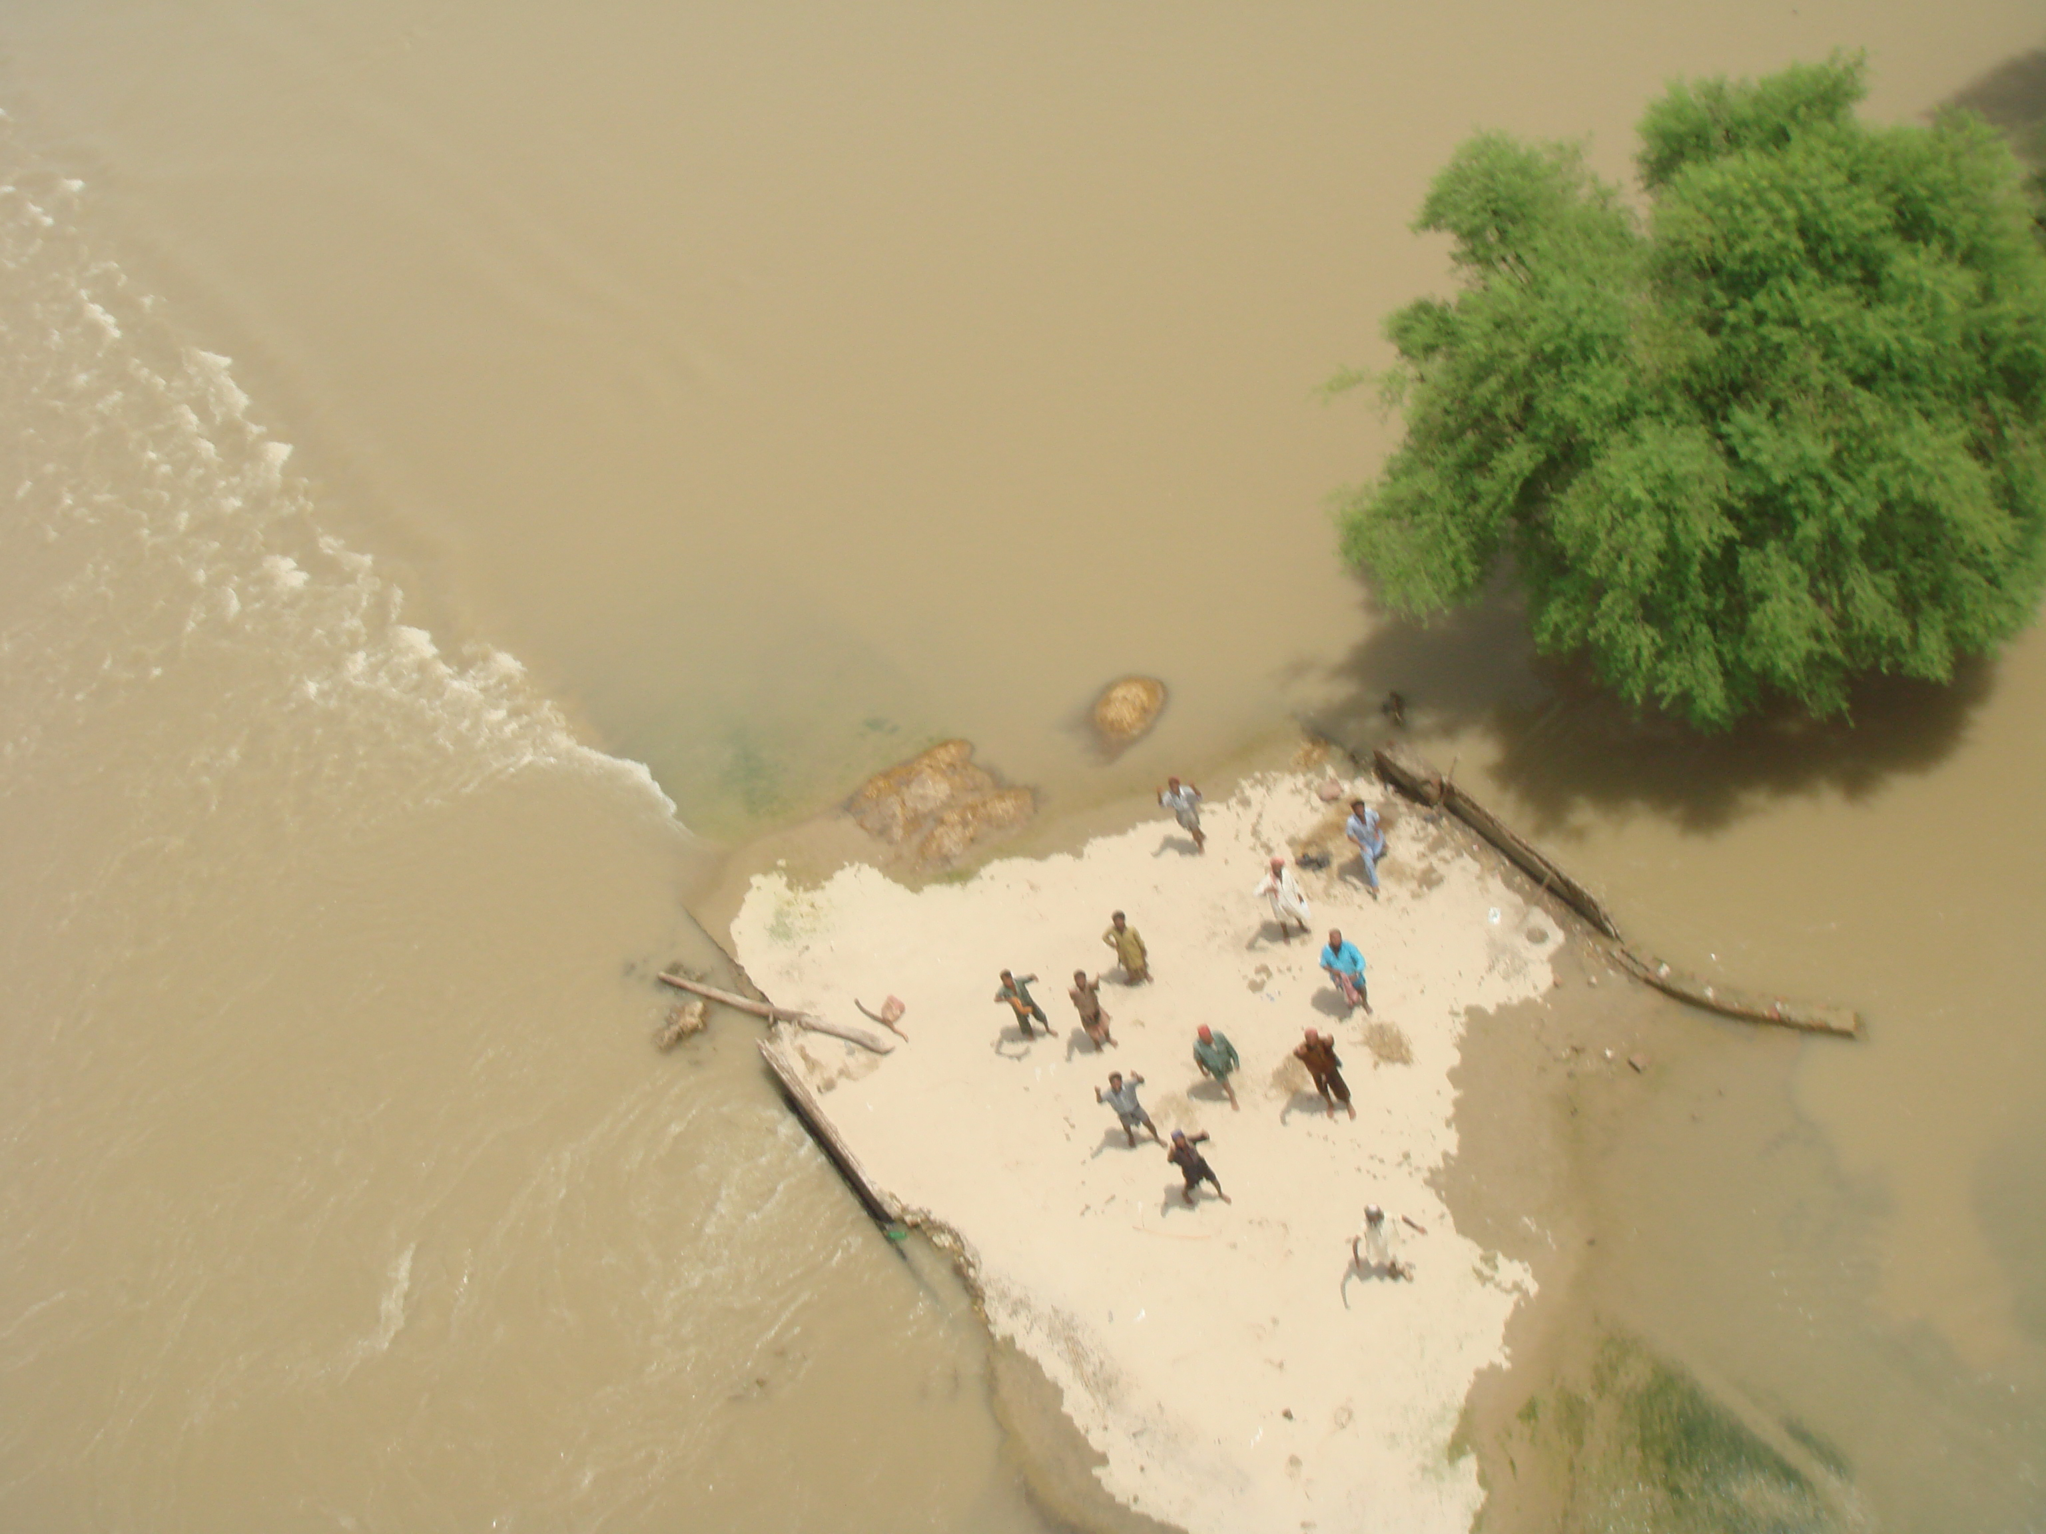

Information and Communication Technology Use in the 2010 Pakistan Floods
a case study by
with funding from the Intel Foundation and Microsoft Corporation

Slide 2
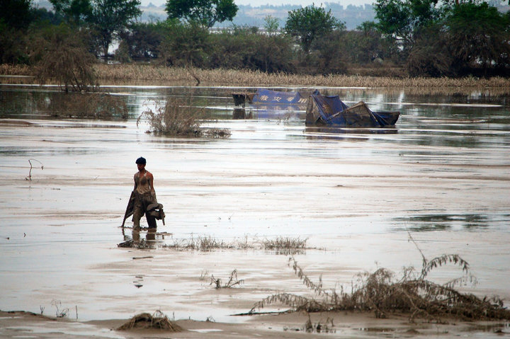
Study Approach
Background
The Humanitarian Response
The Role of Technology
The Role of Information Management
What We Will Look At

Slide 3
Study Approach
Research on
Connectivity
ICT availability
Collaboration
Software
Challenges
Innovation
Information Review
Survey of NetHope members, ETC, IMWG
Interviews within the humanitarian community

Slide 4

Background

Slide 5
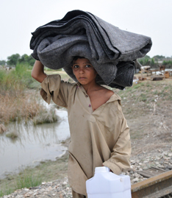
History of Disasters
Earthquakes, cyclones, floods
180 million people live in Pakistan; many live in low coastal areas or river deltas
2005 earthquake: 5.1 million affected, 73,000 dead, $5.2 billion in damages
2010 flood: 20.3 million affected, 1,985 dead, $9.5 billion in damages
Notes:
2010 floods: The Asian Development Bank (ADB) and World Bank (WB) estimated the floods caused around $9.5 billion in damage to infrastructure, farms and homes, as well as other direct and indirect losses (ADB, 2010). The Pakistan government put the figure of direct and indirect losses closer to $43 billion, more than four times the ADB and WB estimate (Fair, 2011).

Slide 6
Technology Landscape
Technologically advanced compared to other developing countries with similar GDP
12% Internet penetration
107 million cell-phone owners
86% of men have a mobile phone; 40% of women have a mobile phone
Use uneven across provinces
Balochistan: 1/3 of people have access
Punjab: more than 51%

Slide 7
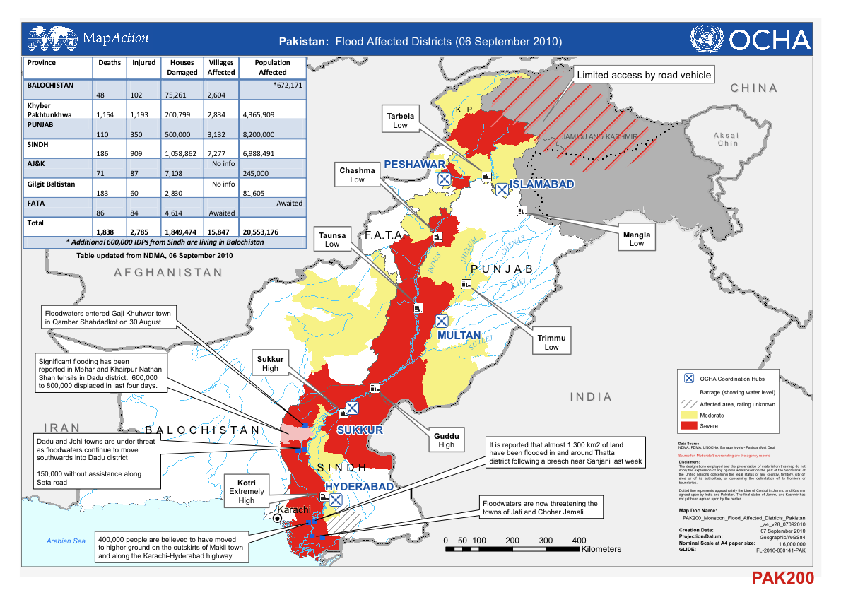
2010 Floods
Notes:
In late July 2010, massive rains in Pakistan and the Himalayas led to unprecedented flooding that submerged one-fifth of the country and affected more than 20 million people (Thomas & Rendón, 2010). The rains lasted for more than eight weeks. What began as seasonal flash floods evolved into one of the most massive disasters in recent time.
The floods affected, directly or indirectly, about two-thirds of Pakistan’s 121 districts
The flooding was predicted just four months earlier in a report written by the Pakistan Task Force on Climate Change.: “it is projected that climate change will increase the variability of the monsoon rains and enhance the frequency and severity of extreme events such as floods and droughts.” (Planning Commission Government of Pakistan, 2010)
The 2010 floods in Pakistan represented disaster on an unprecedented scale. It was largest disaster ever recorded in terms of affected area, affected people and households damaged. The Pakistan floods affected a larger area and more people than those affected by the 2004 Indian Ocean Tsunami, the 2005 Pakistan earthquake and the 2010 Haiti earthquakes combined (Polastro, Nagrah, Steen, & Zafar, 2011).

Slide 8
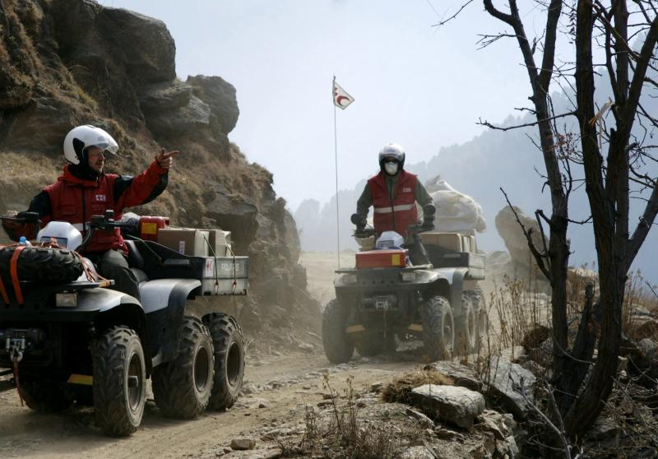
Humanitarian Response
Notes:
The humanitarian response in Pakistan was the largest relief operation ever launched by the international community (Polastro, Nagrah, Steen, & Zafar, 2011).

Slide 9
National Response
Federal Level
Technical-support role
Can deploy & assist military
NDMA
Difficulties sharing information caused lack of coordination
Coordinates disaster response in province
PDMA
Provisional Level
Often lacks capacity to perform roles
District Level
DDMA
Notes:
In Pakistan, it is the role of provincial disaster management authorities (PDMAs) to coordinate disaster response within their provinces. There are district-level disaster management authorities within each province, but in many cases those do not have the capacity needed to perform their role. The National Disaster Management Authority (NDMA) plays a technical-support role at the federal level to the provincial authorities. When a PDMA’s capacity is stretched to its limits, or when a PDMA needs assistance, it sends a request to the NDMA. One of the few physical resources the NDMA can provide is the deployment and assistance of the Pakistan military.
The effectiveness of the PDMAs varied greatly from province to province. In areas that had received significant international assistance in the past, capacity building efforts and years of working with the international community resulted in a more effective response. Conversely, the provinces of Sindh and Punjab had limited experience and capacity to respond to the floods. These were also areas that the international community had not previously been active in and therefore did not have established relationships with the provincial authoritites.

Slide 10
International Response
United Nations Disaster Assessment and Coordination (UNDAC) team:
Support Humanitarian Coordinator & Humanitarian County Team
Set-up & strengthen coordination hubs
Strengthen humanitarian cluster approach
UN and INGOS set up new facilities for better proximity to hubs & field
Provincial authorities disconnected from int’l community response
Notes:
Split large-scale operation by province and coordinating efforts from provincial hubs
UNDAC members dispatched to strengthen coordination hubs & cluster approach

Slide 11
Cluster Approach
Humanitarian organization
Aid organization
info
Personnel & Resources
info
Cluster focused on a particular sector (e.g. agriculture, shelter, etc.)
Large Humanitarian Actor
INGO
info
info
Exchanging information to enable a timely, coordinated and comprehensive humanitarian response to a disaster
Notes:
In the early stages of the 2010 flood emergency, the Pakistan government and the Humanitarian Country Team disagreed about the number of clusters to be implemented. This is something that often occurs, especially if there is a disconnect between the clusters as defined by the UN and the government ministries and organizations involved in the disaster.
12 clusters, 4 sub-clusters
the humanitarian community was already heavily occupied in Haiti, responding to the earthquake that occurred only six months earlier. With insufficient staff, resources and leadership in Pakistan, it was almost inevitable there would be inefficiencies in coordinating the cluster system
many organizations have been reluctant to fully participate. Many organizations feel they are not getting enough value out of their participation. Others point to the overhead caused by clusters as a waste of valuable resources.
A key goal of the cluster approach is to enhance information sharing between the humanitarian actors focused on a particular sector, yet many organizations are reluctant to share information with clusters and other response organizations – a situation that leads to duplicated efforts and gaps in the response. Clearly, organizations need to perceive value in sharing their information, but they often feel that sharing with the cluster is simply an exercise in giving something and getting nothing in return.
The level of participation in the coordination in Pakistan varied greatly between organizations, with some neither providing information to clusters nor to local authorities.
RECOMMENDATIONS
It is recommended that one of two options be put in place for disaster-prone countries: Either existing in-country conference-call services should be set up in advance of disasters, or if these are unavailable, the Emergency Telecommunication Cluster should work with private-sector technology companies to provide a solution-in-a-box for this purpose.
First, it’s important that the clusters’ information management capacity be greatly improved, both with more field-trained staff, but also by providing information management capacity remotely. Second, information management staff members must shift their focus to more productive activities than maintaining contact lists and up-to-date meeting schedules. Third, data shared by cluster members should be shared in a consistent format, eliminating the need for re-formatting of captured data.

Slide 12
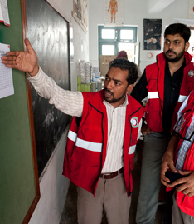
Main Challenges
Resources spread thin
No common operational picture
No data-collection standards
Limited Information sharing due to lack of value perceived by humanitarian community
Disconnect between gov’t & humanitarian community
Notes:
The current approach is to utilize cluster meetings as the main information-sharing platform, but with the high frequency of meetings and the time it took to get to them, some organizations felt that the ends failed to justify the means.
A comprehensive common operational picture of the Pakistan response simply did not exist, and thus a common strategic operational plan was not in place for all of the clusters in each province.
While it is crucial to create a common operational picture, the process was hindered in great part by the fact that information being gathered by the various humanitarian partners was not standardized, as different methodologies were used to both gather and format data (Polastro, Nagrah, Steen, & Zafar, 2011)
While some clusters worked closely together and with the relevant line ministries in the government, many others operated in silos, not sharing information. Even with a large UN OCHA presence (40-50 people) in Pakistan, these people were spread thin, lacking the required capacity and, in many cases, the leadership skills to ensure inter-cluster coordination and information sharing (Polastro, Nagrah, Steen, & Zafar, 2011).
Overall, the lack of cooperation and coordination led to the humanitarian community having an incomplete understanding of the numbers and locations of affected people, their needs, and the activities being executed throughout the region

Slide 13
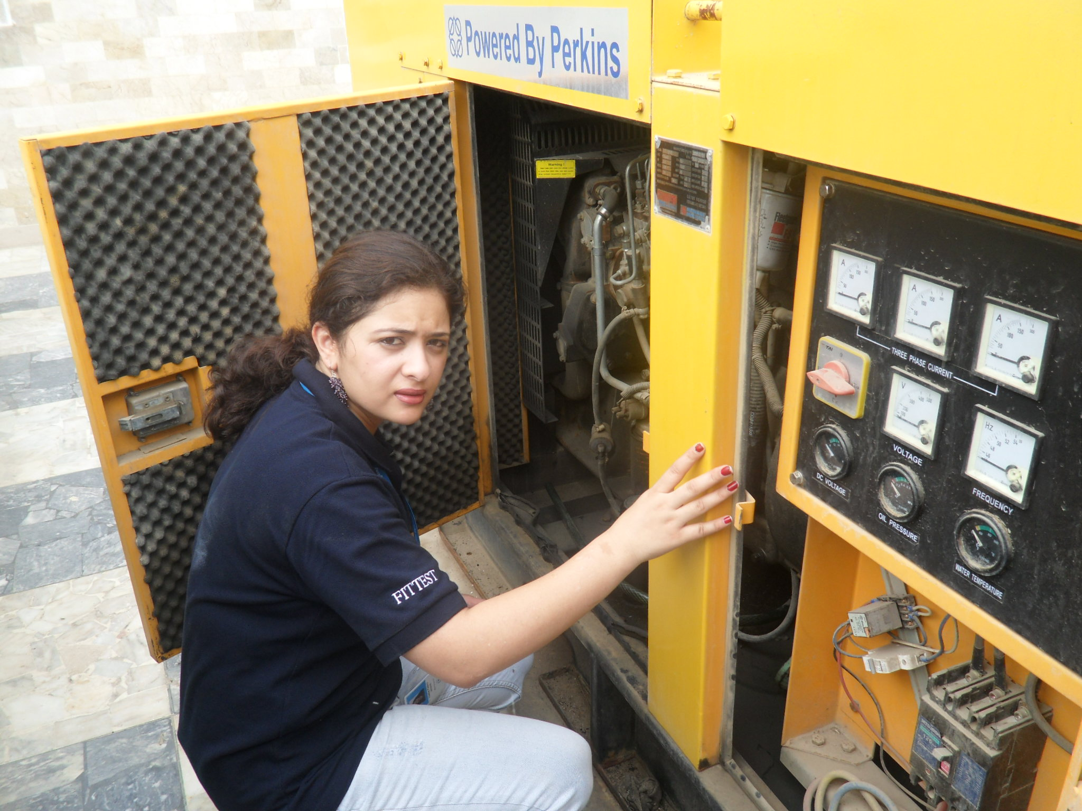
The Role of Technology

Slide 14
Lessons from 2005 Earthquake Response
National ICT staff: knew ICT sector/capacity, existing relationships with NGOs
Need for deep, wide field coordination of ICTs
Custom delays for equipment
Separate VSAT operations (UN vs NGO)
Limited bandwidth
Costly satellite communications
Notes:
• The continuously evolving situation on the ground made it difficult for the humanitarian community to adapt (Polastro, Nagrah, Steen, & Zafar, 2011).
• The Government of Pakistan initially believed it could handle the emergency response and was reluctant to request external assistance; however when the scope of the disaster became more clear, international humanitarian assistance was requested, but this resulted in some delays in mobilization of resources in the early weeks.
• The sheer scale of the emergency meant that the response was soon stretched to its limit. As a result, coverage was limited and generally poorly prioritized (Polastro, Nagrah, Steen, & Zafar, 2011).
• The definition of non-standard clusters/ sectors in the Initial Flash Appeal resulted in some donor confusion on the agencies requesting funds and this delayed the time required to donor pledges of the funds.
• The humanitarian community lacks sufficient staff and resources to stage multiple large-scale operations at the same time (Thomas & Rendón, 2010).
• Information sharing was limited due to lack of perceived value in the humanitarian community.
• In most areas and clusters, there was a disconnect between the work of the Pakistan government and the international humanitarian community.
• In most areas, local authorities lacked the capacity and skills to play a leading role in the response effort.
• While operational coordination often was implemented at the district level (often with support from OCHA), there was a critical disconnect between the INGOs and the district authorities when it came to information sharing (Polastro, Nagrah, Steen, & Zafar, 2011).

Slide 15
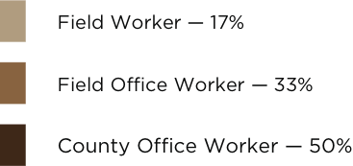
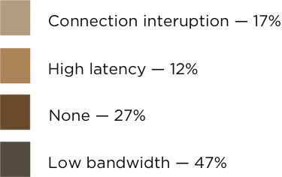


Connectivity
Distribution of Survey Participants
Communications infrastructure largely operational
97%: connectivity was sufficient
Internet via local Internet Service Providers
Recommendations
Utilize different connectivity solutions
ISP vs VSAT
3G mobile networks
Issues with connectivity
Notes:
IN THE 2010 FLOODS
While most NGOs relied upon local ISPs for connectivity, the UN agencies and the ETC also made extensive use of local ISPs when services were available but also relied upon VSAT as backup or to meet short-term peeks. Smaller local NGO implementation partners often relied on GPRS for connectivity.
RECOMMENDATIONS
The humanitarian community needs to look more openly at utilizing different connectivity solutions
In countries where there is a strong ISP presence, and where services have not been severally affected by the disaster, humanitarian organizations should attempt to leverage these services.
The same is true for mobile data networks. With most countries moving toward a 3G wireless broadband mobile network, it is becoming economical and quite easy to provide rapid connectivity with high levels of bandwidth to remote locations.

Slide 16
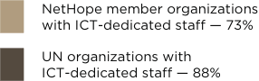
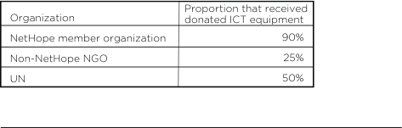

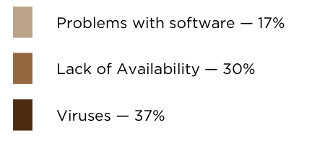
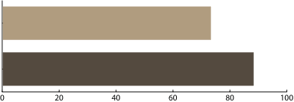
ICT Staff & Equipment
Useful Resources:
Emergency Training (BGAN, VSAT, SatPhone)
Laptops
Solar chargers
USPs
GPS devices
Cameras
Issues faced with donated equipment
Notes:
ICT SKILLS
When asked whether a lack of trained ICT staff had hindered getting connectivity working, one-third of respondents said yes. The percentage was a bit higher within NetHope member organizations than other response groups.
When asked what kind of ICT-related training they felt was most needed, the majority pointed to emergency ICT training (BGAN, VSAT, SatPhone, radio), followed by Cisco product, generic network training and the use of GIS.
DONATED EQUIPMENT
Close to three-fourths of respondents said they had sufficient ICT equipment to perform their role. Those who said they lacked enough equipment mentioned laptops, solar chargers, UPSs, GPS devices and cameras as the most needed. In the field visit, this was supported by the fact that electricity is in short supply in Pakistan, making desktop computers virtually useless because of unreliable power supply.
Those who received donated equipment said it helped very much in the response, saving money that could be used for activities such as direct aid or supplying laptops to replace less-useful desktops. Many of those who did not receive donated equipment said it would not have been terribly useful, though a few noted that additional equipment would have allowed for more independent teams to be deployed.
Almost all of the response organizations reported having issues with equipment being stuck in customs.
RECOMMENDATIONS
agree upon a standardized methodology for performing ICT capacity assessments in affected areas. By agreeing to do so, ICT experts can be trained to perform assessment in affected areas and thereby provide a comprehensive and common overview of ICT capacity.
It is important that ICT capacity be improved in international humanitarian organizations, and that the needs of local implementation partners are addressed in the process. When the technology community is encouraged to contribute in-kind donations of equipment to relief efforts, the needs of these partners also should be included in the appeals.

Slide 17

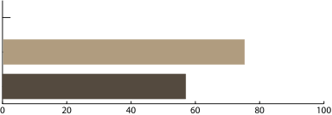

ICT Collaboration & Innovation
USB modems & EVO wireless Internet for mobile connectivity
VPN concentrators for secure data
Mobiles used to access info
Low-cost firewall equipment in field offices
Leverage volunteer tech groups
Notes:
At the same time, only a small number of UN workers (7%) felt collaboration with NetHope members had been rather effective, while 46% said collaboration with the broader community was effective.
This can be linked to the following result: 75% of NetHope members attended NetHope Chapter meetings but only 38% attended ETC meetings. Only one UN worker reported having attended a NetHope chapter meeting.
RECOMMENDATIONS
The humanitarian community and private sector service providers should work to create a joint global ICT services catalogue that gives a comprehensive overview of what ICT services are available and from whom. In disaster-prone countries, work should be done to create local versions of this catalogue.
Improve collaboration between ICT workers at the local level: Emergency ICT collaboration among UN organizations and NGOs must be greatly improved. It is recommended that an ETC coordinator designated by the UN and an ETC NGO coordinator be established in each medium- and large-scale emergency. The NGO ETC coordinator’s role would be to ensure that services and information are being shared between the two communities. To make this possible, funding should be sought for the UN ETC coordinator and the NGO ETC coordinator.

Slide 18
Initial Humanitarian Response
International Humanitarian Partnership
Telécoms Sans Frontiéres
Support UN OCHA
Module: laptop, GPS, digital camera, satellite phone, with tech specialist
Establish basic communication, allow operation without office
ICT support of communication hubs
Free calling services for affected communities
Work with Emergency Telecommunication Cluster on assessments
Notes:
The International Humanitarian Partnership is an informal alliance between eight European donor governments. It provides resources and staff to assist the UN with some of the basic services needed to run a humanitarian operation.
The IHP sent three ICT modules — from Norway, Sweden and Denmark — to support the work of UN OCHA in Pakistan. Each module contained laptops, GPS, digital cameras and satellite phones and was deployed with a technical specialist. The chief purpose of the modules was to provide ICT support to OCHA and enable the team to establish basic communications, provide Internet access and allow OCHA team members to operate simultaneously in different locations where offices had yet to be established
A team from TSF arrived in Pakistan on Aug. 9 with dual roles. One was to support UN OCHA and other humanitarian organizations and work with the ETC by providing ICT support to coordination hubs — mainly the one in Multan, Punjab Province. The other was to set up free calling services for communities affected by the floods. The free calling operations were done by eight mobile two-person teams that were deployed to more 90 locations where people displaced by the floods had gathered. Within the first three weeks, they provided 2,840 affected families with the ability to make phone calls. While this effort was commendable, it benefitted only a small fraction of the 20+ million people affected by the emergency.
Another important role TSF played was to work with the ETC on assessments of the state of the communications infrastructure -- valuable information in areas where the telecommunications or power infrastructure that had failed because of the flooding. In other areas, poor and rural, there are no existing or efficient communication facilities. In areas where GSM networks were operable, people often did not have access to electricity to recharge their phones, and in many cases simply lacked the funds to get airtime credit.

Slide 19
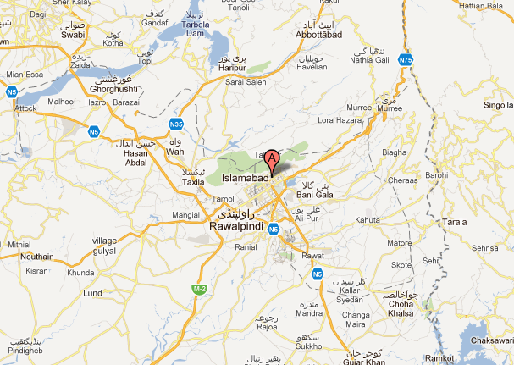
Emergency Telecommunication Cluster
$230,000
Worked with local ICT working group to assess situation & define project plan
Spread data communication services
Coordinate with gov’t
Train staff
Dedicated ETC coordinator
amount of USD given to World Food Programme’s ETC project, which was just 46% of their data communication provision appeal
Notes:
In the first week of August 2010, a dedicated ETC coordinator arrived in Islamabad to enable coordination among the various humanitarian organizations. At the time, most of the operations were taking place in the north, where the UN already had a presence. Existing ETC radio rooms were operating 24/7 to support the efforts. UN offices in the area were utilizing connectivity either through existing VSATs or through local ISPs. GSM networks were affected by the floods and not very stabile.
team performed ICT assessments in the new operational areas, while the UNHCR and UNDSS ICT teams identified locations for new repeater sites in those areas,
Upper Swat Valley was made in collaboration with CARE International’s ICT team. As coordination hubs were established in newly affected areas, the ETC team provided ICT services to the UN community working there.
The ETC also organized an ICT Emergency Management Field Training course in Islamabad, which was delivered twice in the first two months of the response.
The ETC coordination was centrally operated in Islamabad, although ICT experts were sent to the various provinces, primarily to establish and maintain connectivity. The lack of ETC coordination at the provincial level limited collaboration with the extended humanitarian community.
As the 2010 survey revealed, NGOs generally saw little value in attending coordination meetings with the UN agencies, and thus there was little collaboration between them.

Slide 20
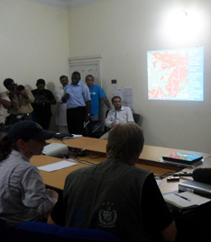
NetHope Response
Global Emergency Response Working Group activated in late July
15 member orgs
Info gathered: ETC briefings, NetHope member org HQ, NetHope Pakistan Chapter
Delivered $250,000 in equipment

Slide 21
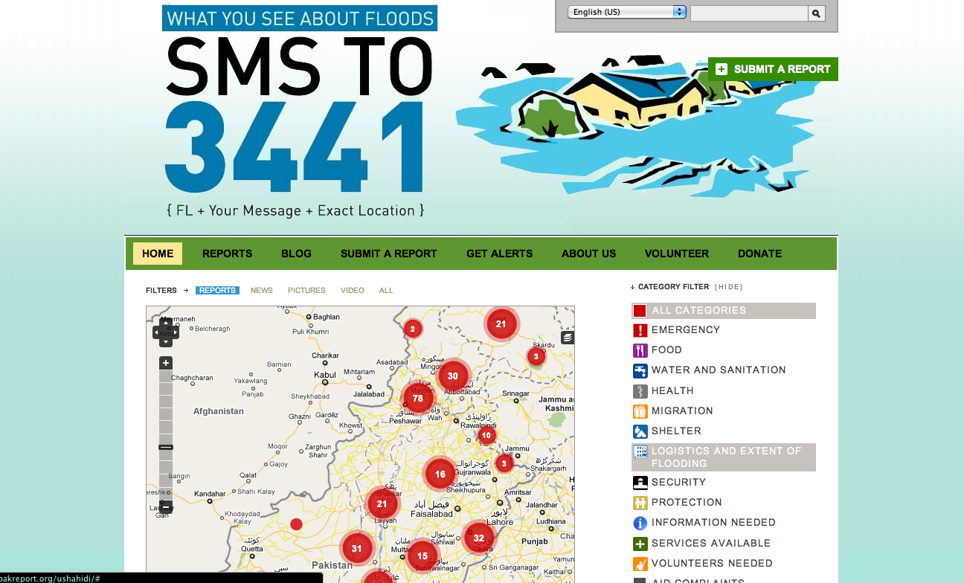
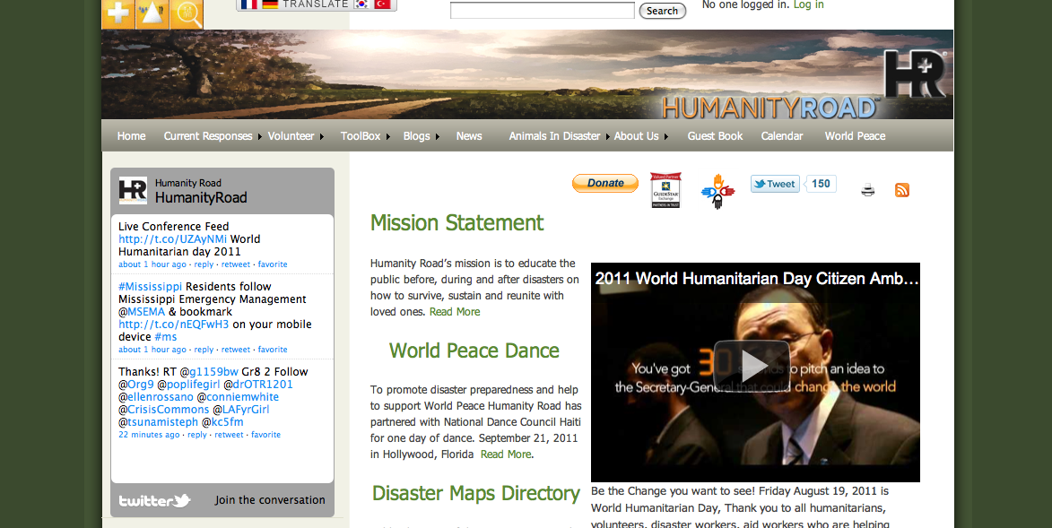
Volunteer Efforts
Notes:
PAK REPORT -- provide up-to-date and verified data from the affected areas. Reports were sorted into the following categories; info submit by SMS
Shortly after the start of the floods, Faisal Chohan, a TED fellow from Pakistan, spearheaded a local effort to use a cloud-based version of Ushahidi called CrowdMap to create the Pakistan Flood Incident Reporting. With assistance from the global volunteer technology community, chiefly Robert Munro and colleagues in San Francisco, this then was linked to a dedicated instance of Ushahidi residing at http://pakreport.org for greater flexibility in adapting the platform to local needs.
A micro-tasking platform from the crowd-sourcing company CrowdFlower was integrated into PakReport to enable the information processing to be coordinated and split into small tasks that volunteers could focus on.
CRISIS COMMONS
A number of CrisisCamps were conducted from August through October at eight different sites: London, Cambridge, Montreal, Calgary, Toronto, Silicon Valley, Bangkok and Sydney.
Included was a global “Round The World CrisisCamp” held Sept. 3-4, during which activities were handed off to teams in different time zones as the days passed.
The CrisisCommons community has a strong volunteer spirit, and there is high interest among its members to help during disasters
Skype group chat sessions and IRC channels were used to coordinate activities among the camps.
HUMANITY ROAD
Humanity Road, an ICT-based digital volunteer NGO, launched its Pakistan response on Aug. 16. It included an event page and social media support in Twitter and Facebook, and also collected and relayed urgent needs and official guidance in email. Meanwhile, Pakistan officials were communicating with aid agencies and the public via meetings and mainstream media, with only a tiny fraction of their communication taking place in social media.
RECOMMENDATIONS
It is recommended that awareness building and training in new open-source tools and processes be provided in disaster-prone countries.
Global digital volunteer communities can serve as mentors to — and provide surge capacity for — these local digital volunteer groups. Through standardized training and methodologies, it can be ensured that people from different countries can work together as one community.

Slide 22

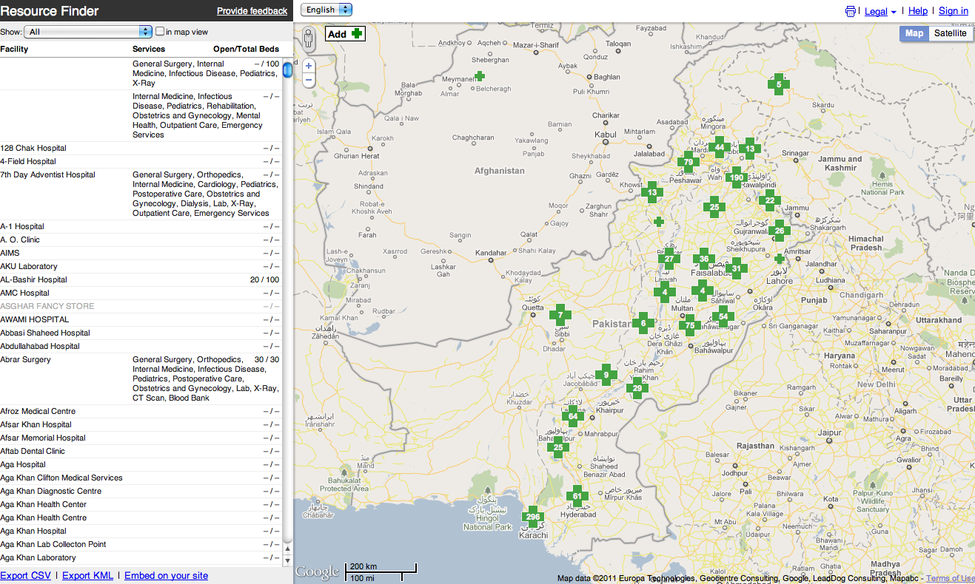
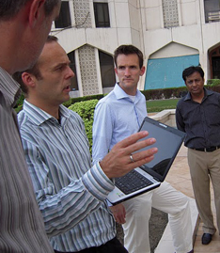

Private Sector Support
Person Finder tool
Resource Finder
Sharing with UNOSAT places & roads from MapMaker community
Donated $5 M in cash, software, tech assistance
Eagle4Pakistan with Geodan & ESRI Netherlands
Notes:
GOOGLE
Google has become increasingly involved in crisis response over the past few years and now has a team that provides technology and geospatial information support to humanitarian organizations involved in response efforts (Google, 2011). This project is an initiative of Google.ORG, the philanthropic arm of Google.
The Person Finder tool was widely utilized. The Resource Finder did not take off and its use by the humanitarian community was limited, as is often the case when new technologies are introduced during a crisis. Sharing of MapMaker data with the humanitarian community was very useful and laid the groundwork for further collaboration between UNOSAT and Google in disaster response.
EAGLE4PAKISTAN
Microsoft Pakistan focused most of its efforts in Punjab Province, where it worked with Punjab’s Chief Minister, Muhammad Shahbaz Sharif, and the PDMA to identify and set up a disaster response solution with Microsoft partners, Geodan and ESRI Netherlands. The solution, called Eagle, displays geospatial data on a map along with relevant background information to give users a common operational picture in different locations. Geodan and ESRI Netherlands donated the Eagle4Pakistan solution and trained government officials to use it, while Microsoft donated technical assistance & licenses.

Slide 23

The Role of Information Management
Notes:
Having the right information is critical to good decision-making and to coordinating activities, yet often in the crisis-management field, decisions are made before the necessary information has been collected, analyzed and shared with appropriate parties.
It is understood that decisions must be made based on the best available information, yet situations tend to change rapidly, and those changes can be unpredictable and unforeseen (Kifayat, et al., 2010). It is often impractical to wait for all relevant information before making decisions in a crisis response, but by disseminating information in a timely manner – highlighting priority needs, gaps and duplications -- the humanitarian community can enhance implementation of its response plans (United Nations, 2010).
Coordination can be improved through effective information management -- leading to enhanced inter-cluster coordination, enhanced national coordination capacity and better planning, all of which serve to support coherent, efficient and effective responses to immediate and medium-term humanitarian needs and early recovery (United Nations, 2010).

Slide 24
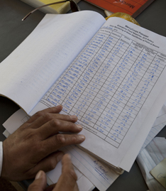
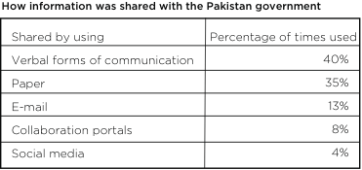
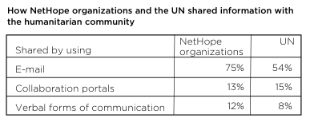
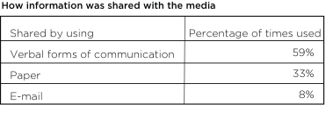
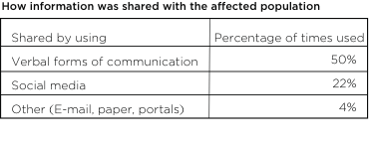
Information Sharing

Slide 25
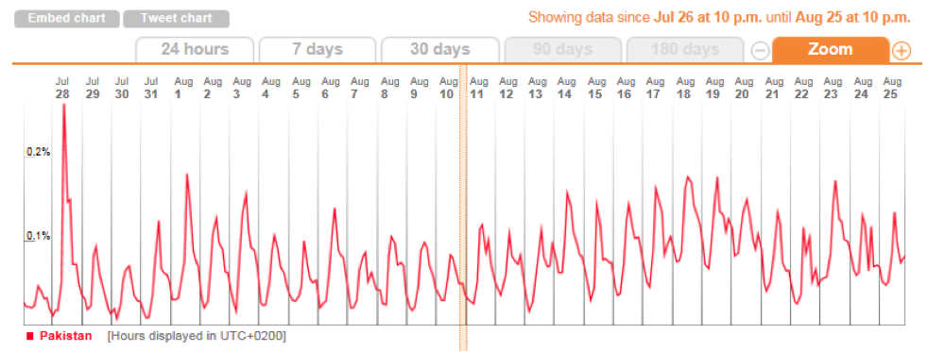


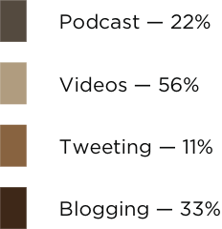

Social Media
NetHope Member Organizations’ HQ
UN HQ
Notes:
Since the Haiti earthquake, the use and potential for crowd-sourcing information aggregation and processing during disasters and mass emergencies has received a great deal of media attention (Starbird, 2011).
Especially during the first couple of weeks in Pakistan, vast numbers of users tweeted about the floods. The hash tag #Pakistan became the top trend on July 28, when a plane crashed near Islamabad. Traffic tapered off over the next couple of weeks (see graph from Trendestic), but on Aug. 16, the hash tag #Pakistan again reached the top-10 list of trending subjects as people began to comprehend the scope of the devastation and the amount of help required from the rest of the world (Rezwan, 2010).
The types of messages being tweeted fell into four general categories:
• Stories and images of the flood victims.
• Flood information.
• Donation drives.
• Information on rescue and relief efforts.
RECOMMENDATIONS
To improve the speed at which crowd-generated information can be made available to the humanitarian community, short-codes should provide pre-established information to those in disaster-prone countries before disasters strike. Such an approach allows for awareness building among citizens before a disaster hits and ensures that the system for capturing these messages is in place before the emergency.
It is recommended that the humanitarian community and the digital volunteer community under the guidance of the International Telecommunications Union (ITU) approach the GSMA — the worldwide association of mobile operators — to put in place the infrastructure and agreements needed in the key disaster-prone countries of the world.

Slide 26
Information Flow
50+
Visibility & sharing of info hampered by poor cluster performance
Lack of dedicated information management capacity
Single-agency needs assessments vs joint assessments
Delayed SRF (6 months)
Information management specialists were deployed to Islamabad & other coordination hubs. UN said it wasn’t enough to improve capacity within UN.
Large # of clusters
made it critical to strengthen the information flow and enable improved gap analysis of the response
Notes:
The UN OCHA lacked clear and consolidated information about the activities of the various response organizations. It took almost six months before a common approach to activity reporting was agreed upon and implemented.
Humanitarian organizations did not effectively share information with each other. The same held true for sharing with local authorities. Organizations perceived little value in doing so.
Although some initial joint-agency needs assessments were successful, most organizations reverted to doing their own assessments and seldom shared the results with the broader community. Due to incompatibility in methodologies and data formats, integrating results was virtually impossible.
The SRF is a web-based tool for monitoring interventions and relief-item delivery. Data entered into the system is available to the entire humanitarian community and is intended to help ensure transparency and accountability. The rollout of this tool has been slower than expected. The IM and GIS working groups promoted a single reporting format (SRF) in mid-January 2011 — almost six months into the response – after delays caused by lack of consensus between the Pakistan government (represented by NDMA) and the Humanitarian Country Team about the design (content, details, etc.).
Without a standardized report format, UN OCHA lacked clear and consolidated information on the various response organizations’ activities – there was no precise data specifying what actions had been taken, where and by whom. In some clusters, attempts were made to address this by gathering information at cluster meetings, thus preventing the meetings from being used for strategic programming (Polastro, Nagrah, Steen, & Zafar, 2011)
RECOMMENDATIONS
There is a crying need for the humanitarian community, as well as the technology private sector, to agree upon a standardized methodology for performing ICT capacity assessments in affected areas. By agreeing to do so, ICT experts can be trained to perform assessment in affected areas and thereby provide a comprehensive and common overview of ICT capacity.
Data formats and templates should be made public, translated into various languages and actively promoted toward line ministries in disaster-prone countries. With standardized templates, it becomes possible for technology companies and volunteer communities to help develop solutions that can be used. Without such information, the humanitarian community lacks a strategic overview and therefore cannot prioritize assistance within and across clusters. Without this integrated information, there is no way to monitor results, leading to lack of accountability toward populations, peers and donors (Polastro, Nagrah, Steen, & Zafar, 2011).

Slide 27
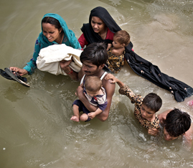
Sharing Information with the Affected
“Floods are the most frequent and recurring natural disasters”
Support radio stations & local journalists
No early-warning facilities to send alerts
Improve by utilizing radio stations & mobile tech (fundraise SMS, hotlines)
Disseminate info through multiple channels
Notes:
Multiple channels are needed to disseminate information — through press releases, information bulletins shared with local media, social networks, mobile networks (through SMS broadcasting) and websites.
NO EARLY WARNING
Pakistan has a flood monitoring and observation system in place, but it lacks early-warning facilities to disseminate alerts to communities (ESCAP, 2010). By and large, the public was unaware of flood response strategies and what was expected of them. A comprehensive early-warning system can improve the community’s understanding and enhance its capacity to take precautions and take action. Such a system is highly needed, but is not being addressed because of budget and political issues (Mustafa & Wrathall, 2011).
MOBILE NETWORKS
The Pakistan Telecommunication Authority started, in collaboration with all mobile operators, a fundraising campaign called “1234” that allowed people to utilize SMS services for donations to the flood relief activities (the Prime Minister’s Flood Relief Fund, 2010). By sending the text “FUND” as an SMS to the number 1234, 10 Rupees were contributed toward the relief fund (Faheem, 2010).
Save the Children piloted a program in early August 2010 that allowed affected communities to make voice calls or send an SMS text message to a hotline. Affected communities in three flood-stricken provinces used the hotline to make complaints or offer suggestions relating to Save the Children’s work. In the first three months of the service, scores of people had used it, and in so doing were granted a voice in the relief efforts (Save the Children, 2010).
The helpline identified issues that were later addressed, including reported fraud, lack of drinking water and staff behavior. Dedicated staff carried hotline-dedicated mobile phones, logged all complaints and followed up within 24 hours. The pilot was so successful, it was extended to cover all areas where Save the Children worked.
RECOMMENDATIONS
As mobile phone ownership and the use of social networks and social media continue to grow exponentially, it is important that new approaches to early warning systems leverage these changes.

Slide 28
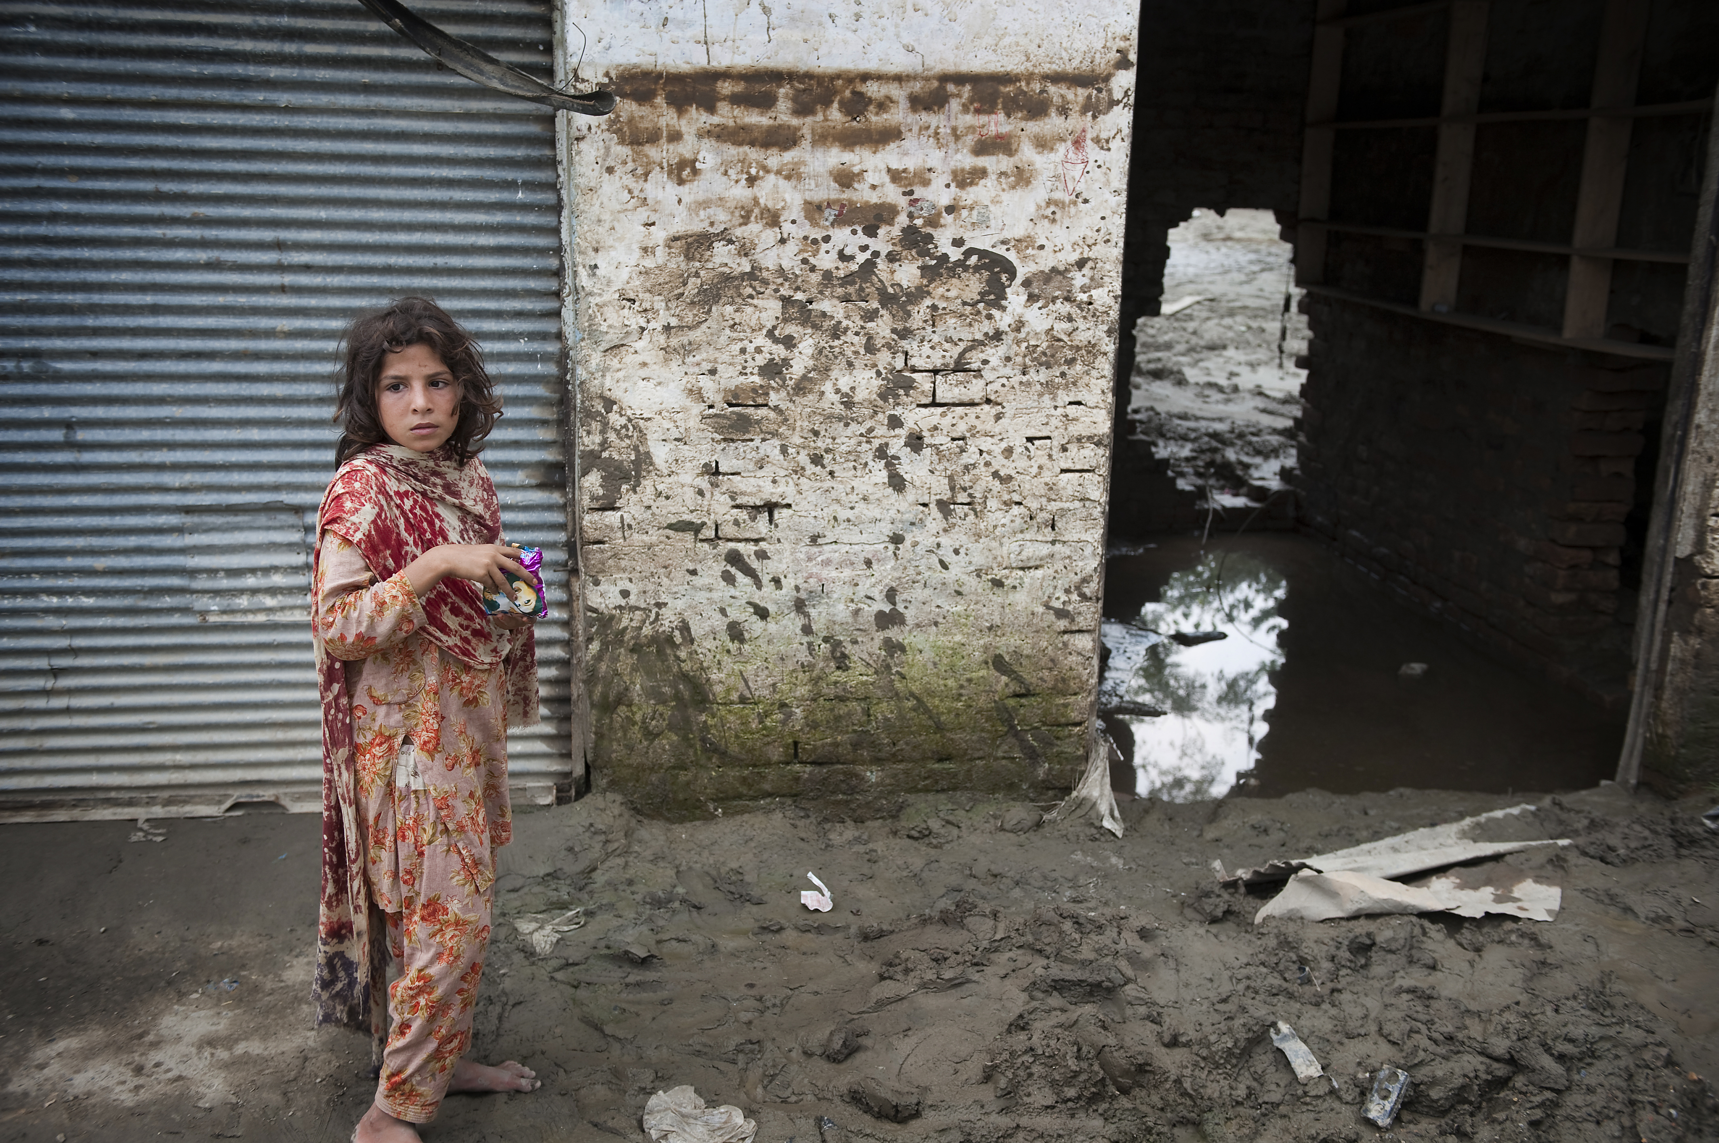
Conclusion
Notes:
There are a number of ways in which information technology and improvements in information management could have enhanced relief efforts in Pakistan, yet apart from the use of broadband, the humanitarian community’s use of technology had changed very little in the six years since the 2005 Kashmir earthquake. New and innovative ways of utilizing social media, mobile networks and crowd-sourcing met a difficult resistance from the humanitarian community. Often this resistance was due to lack of capacity within the community itself to deal with basic information management needs.
It is essential that we leverage improvements in connectivity to move some of these capacity issues from the field into locations that have sufficient bandwidth and personnel to work on more complex analytical issues. At the same time, we must leverage the power of crowds of digital volunteers to help with easier, mundane tasks. To do this, we must move toward open data standards and implement processes that allow us to scale our efforts in these new ways.
While humanitarian response organizations have adopted various aspects of ICT into their daily operations, there is great variance between these organizations and an overall lack of interoperability between developed systems. Websites, portals, wikis, blogs and social networking sites have revolutionized the way information is shared within organizations and, in some cases, have helped broaden the scope of external information dissemination (Harvey, Stoddard, Harmer, Taylor, Didomenico, & Brander, 2010).
Climate change and urbanization are expected to rapidly expand the scale of disasters (Okazaki, et al., 2010), and the humanitarian community – with its operating budgets imperiled by the economic crisis – could struggle to keep up. It is therefore important that the humanitarian community start reaping some of the benefit of the information revolution to enhance and scale its operations even further.
Given the high cost of adopting new technologies and adapting solutions for use within the humanitarian community, collaboration across the community is essential. Through broader collaboration, it will become easier to involve private sector technology industries and gain their support in creating solutions to the many problems encountered in relief operations around the world.
Through a consolidated effort by the broad humanitarian community, the private sector, governments in disaster-prone countries, and the donor community, we can take enormous steps forward in the ways in which technology enhances humanitarian operations worldwide.

Slide 29
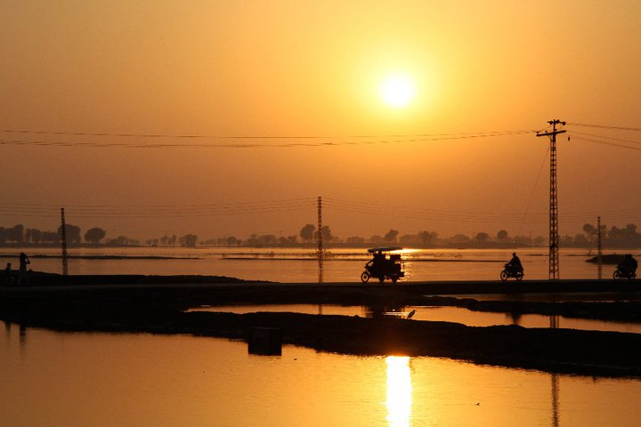
Questions?
[e-mail]
www.NetHope.org

Slide 30
ADB. (2010, October 14). ADB-WORLD BANK ASSESS PAKISTAN FLOOD DAMAGE AT $9.7. ADB News Release . Mainila, Philippines: Asia Development Bank.
Carlos, A. (2011, 03 21). Helping Governments Recover from Disasters: Microsoft and Partners Provide Technology and Other Assistance Following Natural Disasters in Haiti and Pakistan . (Microsoft Corporation) Retrieved 06 22, 2011, from Microsoft Case Studies: http://www.microsoft.com/casestudies/Case_Study_Detail. aspx?CaseStudyID=4000009431
Cedar, O. (2011). A Failure of Conscience: How Pakistan’s Devastating Floods Compare to America’s Experience During. Sustainable Development Law & Policy , 11 (1), 46-71.
Cosgrave, J., & Herson, M. (2008). Perceptions of crisis and response: A synthesis of evaluations of the response to the 2005 earthquake. London: ALNAP.
Currion, P. (2005). Information and Technology Requirements Initiative - Assessment Report: Pakistan Earthquake Response. Emergency Capacity Building Project.
De Groeve, T., & Riva, P. (2009). Global real-time detection of major floods using passive microwave remote sensing. Proceedings of the 33rd International Symposium on Remote Sensing of Environment. Stresa, Italy.
ESCAP. (2010). Chairman Summary. Regional High-Level Expert Group Meeting to Reduce Flood Disaster Risk in Pakistan. Islamabad: ESCAP.
ETC Cluster. (2010). ETC Cluster Project Request. Retrieved 06 03, 2011, from FTS: http://ops.unocha.org/Reports/daily/CAPProjectSheet_905_34035_2011517.pdf
Faheem, A. (2010, 08 14). Mobile Operators Respond to Flood Relief. Retrieved 06 06, 2011, from Telecomistan: http://www.telecomistan.com/2010/08/mobile-operators-respond-to-flood-relief-calls/
Fair, C. C. (2011). Pakistan in 2010 - Flooding, Governmental Inefficiency, and Continued Insurgency. Asian Survey , 51 (1), 97-110.
Farooqi, A. B., Khan, A. H., & Mir, H. (2005). Climate Change Perspecitve in Pakistan. Pakistan Journal of Meterology , 2 (3), 13-21.
Google. (2011). About Google Crisis Response. Retrieved 06 07, 2011, from Google Crisis Response: http://www.google.com/crisisresponse/about.html
Gronewold, N. (2010, 10 13). Pakistan: Climate change, deforestation and corruption combine to drown a region. Retrieved 5 17, 2011, from ClimateWire: http://www.eenews. net/public/climatewire/2010/10/13/1
Grumm, R. H., & Bosart, L. (2010). Pakistani Floods of July-August 2010. State College: National Weather Service.
Haider, Z. (2010 йил17-08). Pakistan military enhances image with flood relief effort. Retrieved 2011 йил17-05 from Reuters: http://www.reuters.com/article/2010/08/17/us-pakistan-floods-military-idUSTRE67G2P620100817
Hameedi, T. (2010, 09 30). Using SMS to pinpoint humanitarian needs. Retrieved 06 07, 2011, from Converge Technologies: http://blog.converget.com/2010/09/30/using-sms-to-pinpoint-humanitarian-needs/
Harvey, P., Stoddard, A., Harmer, A., Taylor, G., Didomenico, V., & Brander, L. (2010). The State of the Humanitarian System: Assessing Performance and Progress - A Pilot Study. London: Overseas Development Institute.
IASC. (2006, 11 24). GUIDANCE NOTE ON USING THE CLUSTER APPROACH TO STRENGTHEN HUMANITARIAN RESPONS. Retrieved 7 30, 2011, from Humanitarian Reform: http://www.humanitarianreform.org/humanitarianreform/Portals/1/cluster%20 approach%20page/Introduction/IASCGUIDANCENOTECLUSTERAPPROACH.pdf
IHP. (2010, 08 03). IHP News. Retrieved 06 03, 2011, from IHP Supports the UN in Pakistan: http://www.ihp.nu/news/37-ihp-supports-the-united-nations-in-the-pakistan-emergency.html
Khan, H., & Khan, A. (2008). Natural hazards and disaster management in Pakistan. Muni Personal RePEc Archive .
Kifayat, K., Llewellyn-Jones, D., Arabo, A., Drew, O., Merabti, M., Shi, Q., et al. (2010). State-of-the-Art in System-of-Systems Security for. The Fourth Annuaal Layered Assurance Workshop. Austin, Texas, USA: Applied Computer Security Associates.
Meier, P., & Munro, R. (2010). The Unprecedented Role of SMS in Disaster Response: Learnings from Haiti. SAIS Review , 30 (2), 91-103.
Mustafa, D., & Wrathall, D. (2011). Indus Basin Floods of 2010: Souring of a Faustian Bargain? Water Alternatives , 4 (1), 72-85.
Okazaki, A., Nitta, T., Yamazaki, D., Yoshimura, K., Watanabe, M., Kimoto, M., et al. (2010). Estimation of flood risk change under global warming using the latest. Climatic Changes in Monsoon Asia (CCMA). Bangkok, Thailand: Japan Society for the Promotion of Science (JSPS).
Oxley, M. (2010). Pakistan Floods : Preventing Future Catastrophic Flood Disasters. London, UK: Global Network of Civil Society Organisations for Disaster Reduction.
Pakistan Telecom Authority. (2011, 6 3). Telecom Indicators. Retrieved 7 30, 2011, from Pakistan Telecom Authority Web Site: http://www.pta.gov.pk/index.php?option=com_co ntent&view=article&id=269:telecom-indicators&catid=124:industry-report&Itemid=599
PakReport. (2011, 01 22). PakReport Reports. Retrieved 06 07, 2011, from PakReport: http://pakreport.org/ushahidi/reports
Planning Commission Government of Pakistan. (2010). Task Force on Climate Change - Final Report. Islamabad: Planning Commission Government of Pakistan.
Polastro, R., Nagrah, A., Steen, N., & Zafar, F. (2011). Inter‐Agency Real Time Evaluation of the Pakistan Floods. IASC.
Qamar, S. (2009 йил27-05). Mobile phone technology fast growing in Pakistan : WB. Retrieved 2011 йил17-05 from The Nation: http://www.nation.com.pk/pakistan-news-newspaper-daily-english-online/Business/27-May-2009/Mobile-phone-techonology-fast-growing-in-Pakistan-WB
Rezwan. (2010, 08 25). Pakistan: Twitter Reactions On Flood Situation. Retrieved 06 06, 2011, from GlobalVoices: http://globalvoicesonline.org/2010/08/25/pakistan-twitter-reactions-on-flood-situation/
Save the Children. (2010, 10 28). Save the Children’s SMS Texting Program Helps Pakistani Flood Survivors to Help Themselves. Retrieved 06 07, 2011, from Save the Children: http://www.savethechildren.org/site/apps/nlnet/content2.aspx?c=8rKLIXMGIpI 4E&b=6230287&ct=8843229
Starbird, K. (2011). Digital Volunteerism During Disaster: Crowdsourcing Information Processing. CHI 2011. Vancouver, BC, Canada: ACM.
Thomas, A., & Rendón, R. (2010). Confronting Climate Displacement: Learning from Pakistan’s Floods. Washinton DC: Refugees International.
UN Secretary General. (2011). Strengthening emergency relief, rehabilitation, reconstruction and prevention in the wake of devastating floods in Pakistan. New York: United Nations General Assemby.
UNDAC. (2010). UNDAC Mission Report to Pakistan Floods 2010. Geneva: UN OCHA, FCSS.
United Nations. (2010). Pakistan Floods Relief and Early Recovery Plan. Islamabad: UN OCHA.
UNOSAT. (2010, 08). UNOSAT Integrates Google Map Maker Data to step up mapping efforts in Pakistan. Retrieved 06 07, 2011, from UNITAR: http://www.unitar.org/google-map-maker-data-step-mapping-efforts-over-pakistan
Wall, I., & Robinson, L. (2008). Left in the dark - The unmet need for information in humanitarian response. London: BBC World Service Trust.
WikiPedia. (2011, 06 03). Indus River. Retrieved 06 03, 2011, from WikiPedia: http:// en.wikipedia.org/wiki/Indus
WikiPedia. (2011, 06 03). Pakistan. Retrieved 06 03, 2011, from WikiPedia: http:// en.wikipedia.org/wiki/Pakistan

